Slide 1
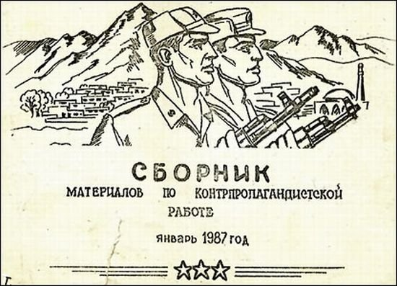
Handbook of Materials for Counter- propaganda Work January 1987

Slide 2
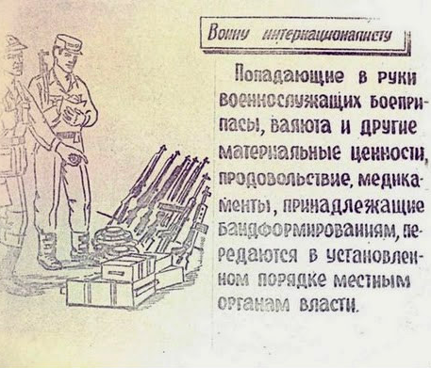
If items belonging to the band formations [mujahedeen] are discovered by [Soviet] soldiers, be they weapons, foreign currency or other valuables, goods, medicine, it should be turned over according to protocol to the local [Afghan] organs of power. 1 of 22

Slide 3
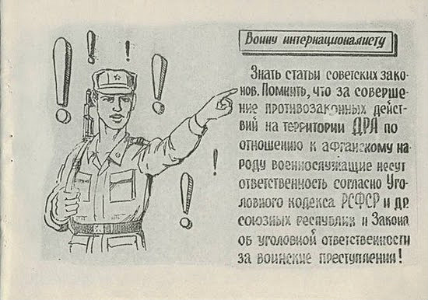
Know the articles of Soviet law. Remember that for any illegal action carried out in the DRA against the Afghan people a soldier is held responsible according to the law code of the Russian Federation and other Soviet Republics and laws regarding war crimes! 2 of 22

Slide 4
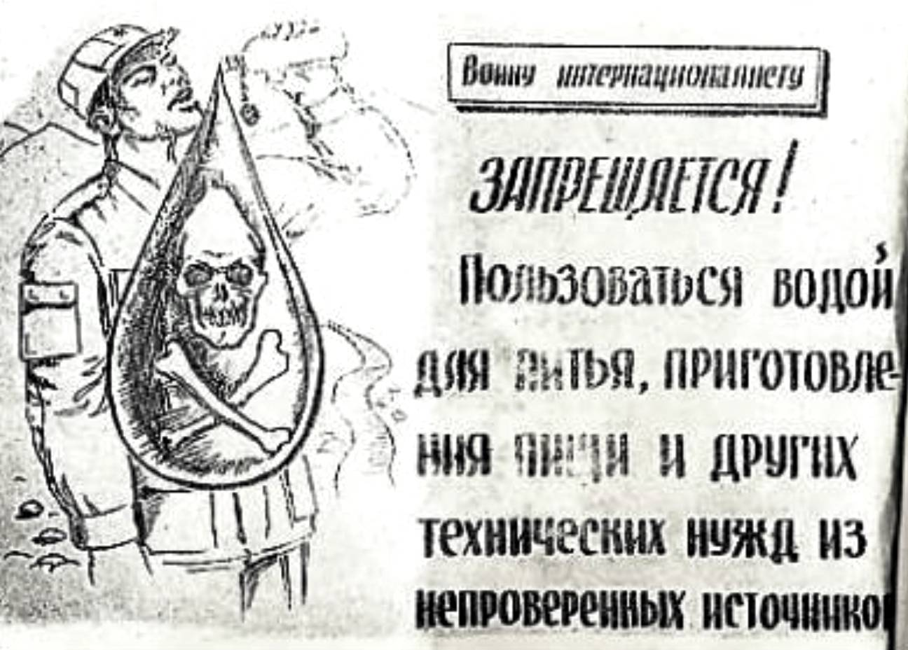
Forbidden! To use drinking water, or water for food preparation or other technical needs from an unchecked source. 3 of 22

Slide 5
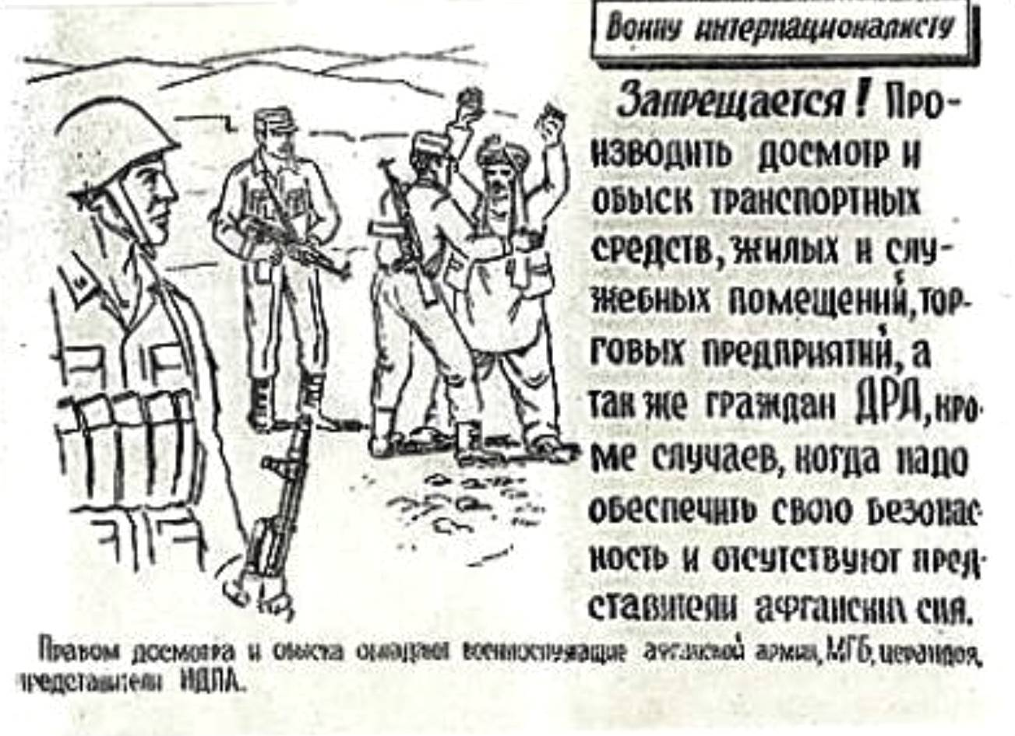
Forbidden! To search a citizen of the DRA on the road, in their home or place of work or business (trade) except in cases when necessary to insure your own safety and there are no representatives of Afghan authority around to do so for you. 4 of 22

Slide 6
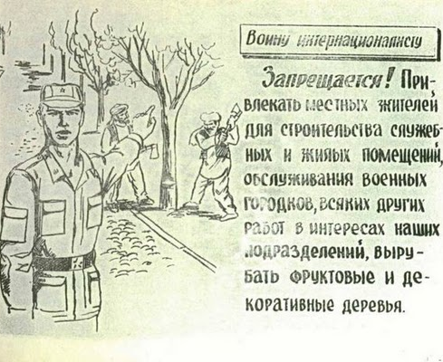
Forbidden! To recruit locals for the construction of military or living quarters, to work in military camps, or to do other work for our troops, or to cut down fruit or decorative trees. 5 of 22

Slide 7
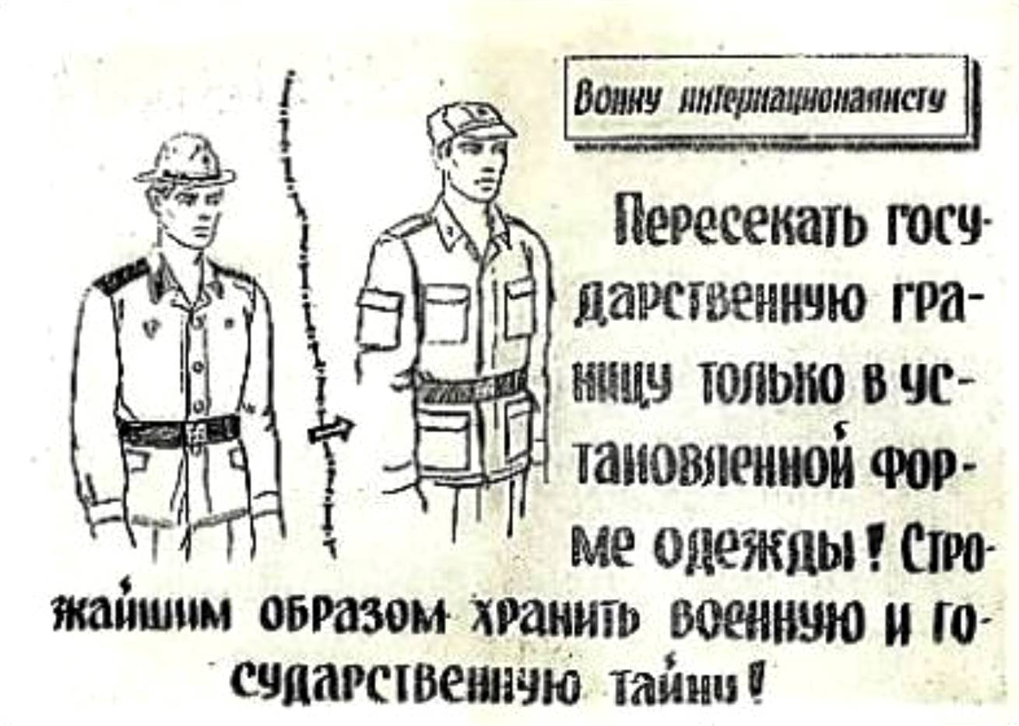
Cross state borders only in an approved military uniform! Strictly guard military and state secrets! 6 of 22

Slide 8
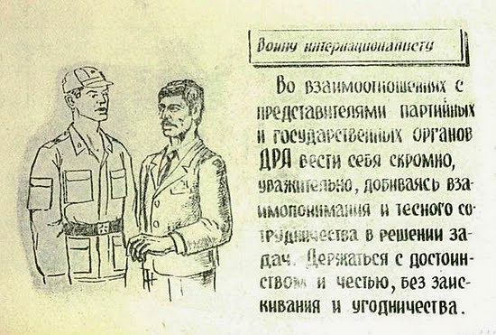
In relationships with representatives of party or government organs of the DRA always behave humbly, respectfully, reach a mutual understanding and maintain close cooperation in the solution of tasks. Maintain honor and dignity without kowtowing and servility. 7 of 22

Slide 9
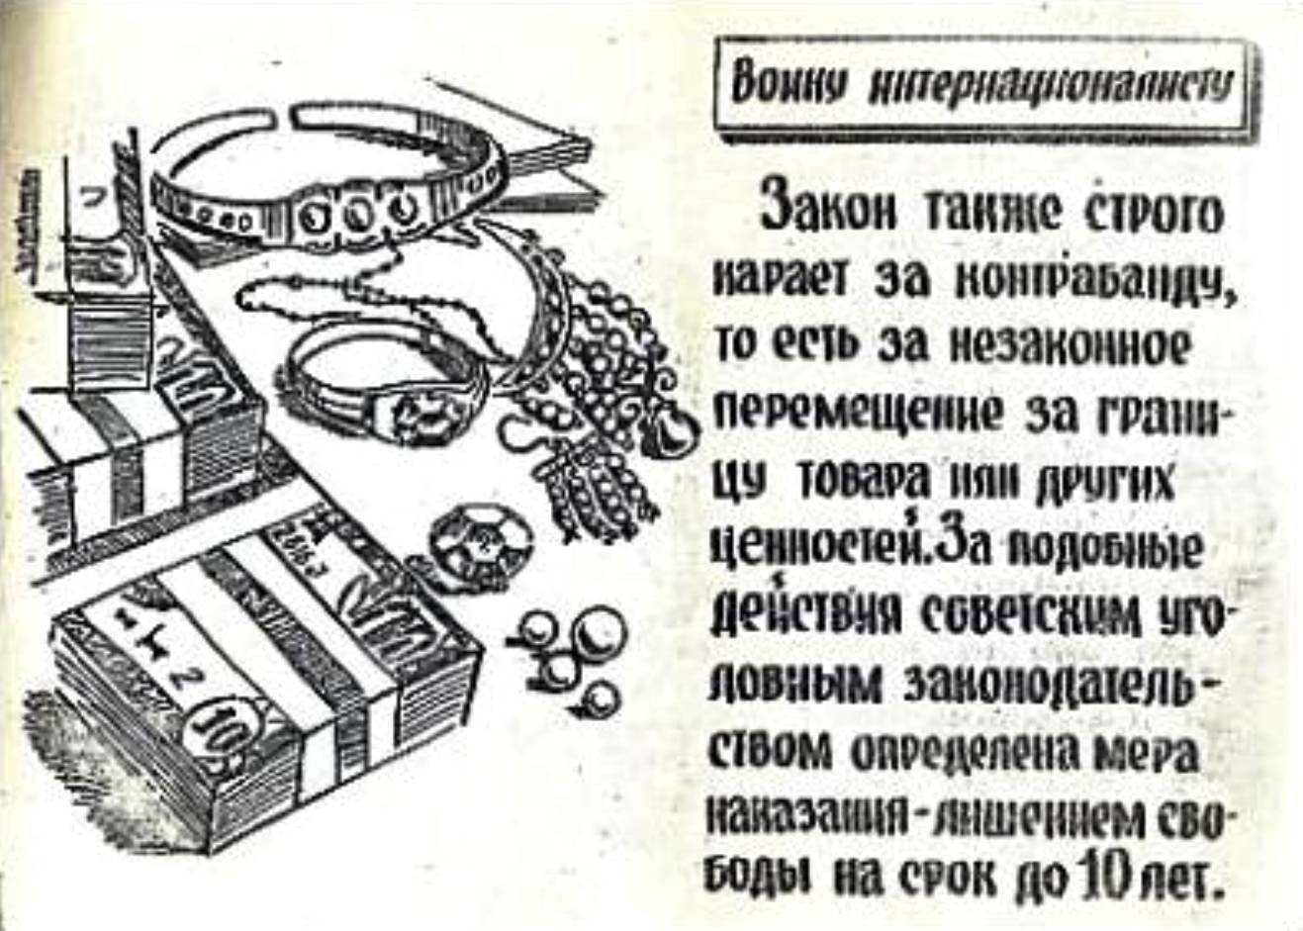
The law also strictly forbids contraband as it is illegal to take goods or valuables out of the country. For such acts the Soviet legal code stipulates a 10-year prison sentence. 8 of 22

Slide 10
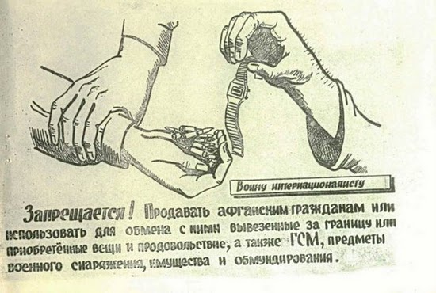
Forbidden! To sell to Afghan citizens or trade with them for items from abroad or basic goods and products, military items and materials, property, or weapons. 9 of 22

Slide 11
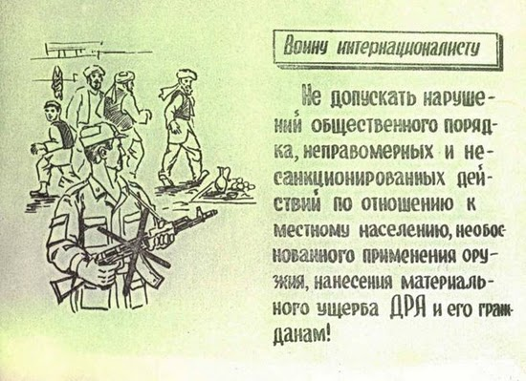
Do not disrupt social order, carry out unjustified and unsanctioned actions toward the local population, use one’s weapon without basis, or cause material loss to the DRA and its citizens! 10 of 22

Slide 12
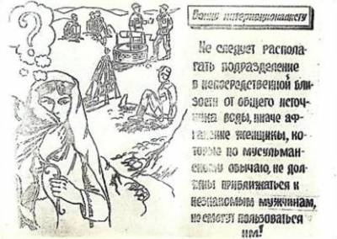
Do not use sources of water very close to common water wells because otherwise women, who according to Muslim customs are not supposed to be close to unfamiliar men, cannot use the water wells. 11 of 22

Slide 13
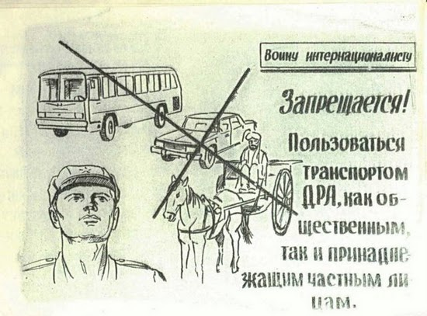
Forbidden! To use public transport in the DRA or accept a ride with a private citizen. 12 of 22

Slide 14
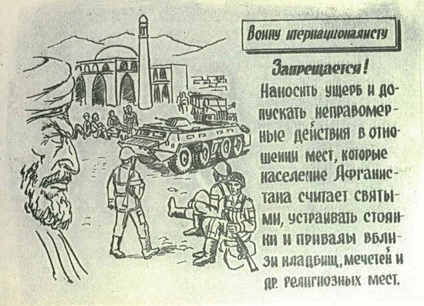
Forbidden! To cause harm to or carry out unjustified actions toward places the Afghan population considers holy, such as parking or setting up camps near cemeteries, mosques and other religious places. 13 of 22

Slide 15
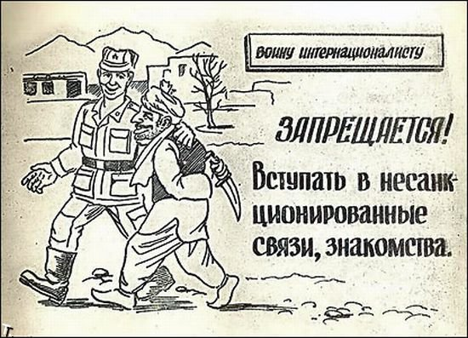
Forbidden! To enter into an unsanctioned relationship or acquaintance (with an Afghan citizen). 14 of 22

Slide 16
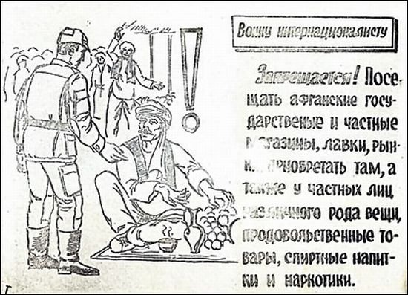
Forbidden! To visit Afghan government or private stores, kiosks, or markets, to buy anything there, or from private individuals offering a variety of items, basic goods, alcohol, and narcotics. 15 of 22

Slide 17
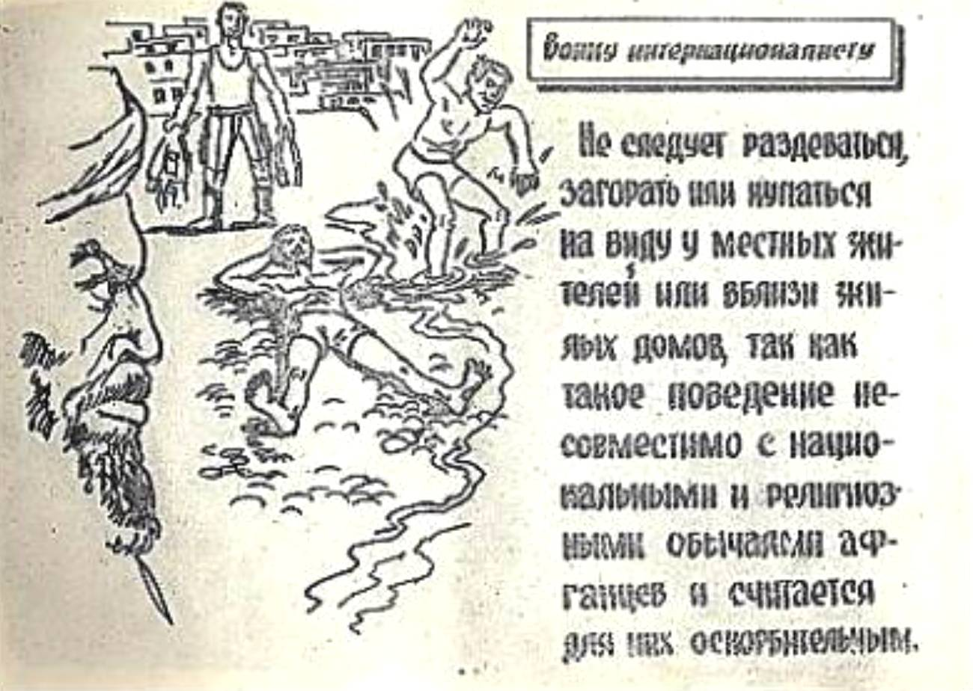
Do not dress skimpily, suntan, or swim in front of local’s homes as such behavior does not correspond with the national or religious traditions of Afghans and they consider such actions insulting. 16 of 22

Slide 18
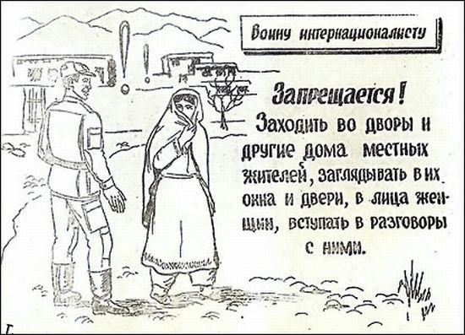
Forbidden! To go into the courtyards or homes of local residents, look into their windows or doors, look at women’s faces, or start a conversation with them. 17 of 22

Slide 19
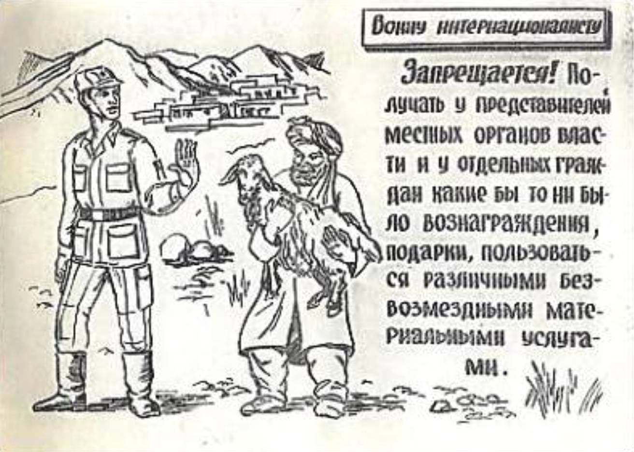
Forbidden! To receive from representatives of local organs of power or separate citizens some kind of rewards or gifts as compensation for various material aide or services. 18 of 22

Slide 20
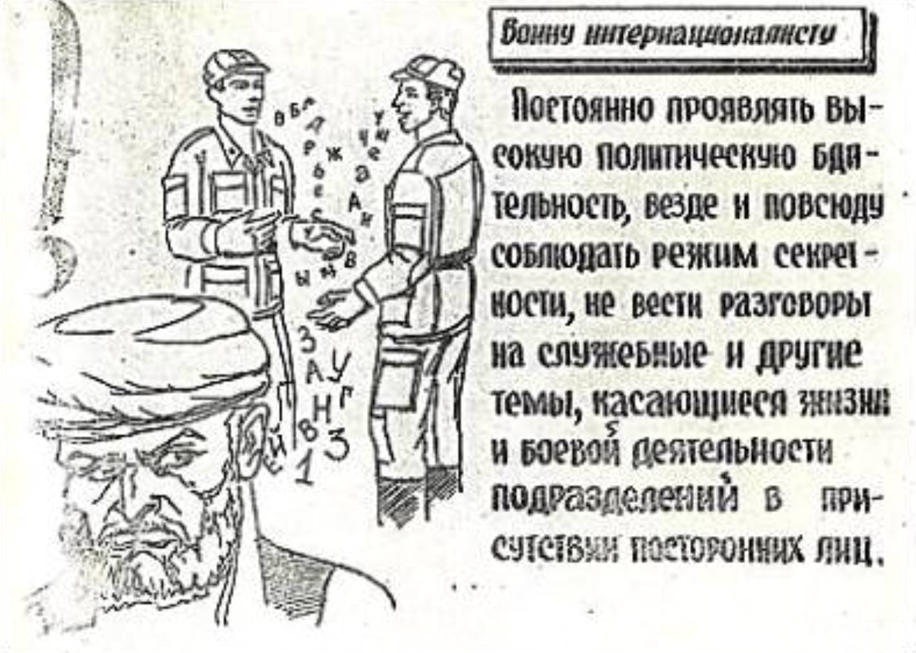
Constantly observe a high degree of political vigilance, always and everywhere follow a regime of secrecy, do not converse about service or other topics dealing with military affairs in the presence of strangers. 19 of 22

Slide 21
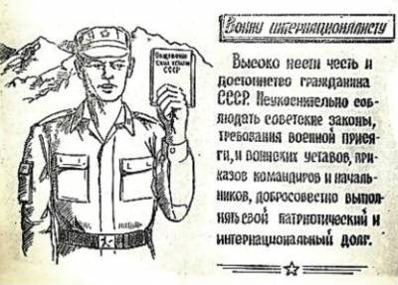
Hold to the high honor and dignity of a citizen of the USSR. Strictly observe Soviet laws, the demands of military service, military statutes, the orders of commanders, and carry out in good faith your patriotic international obligation. 20 of 22

Slide 22
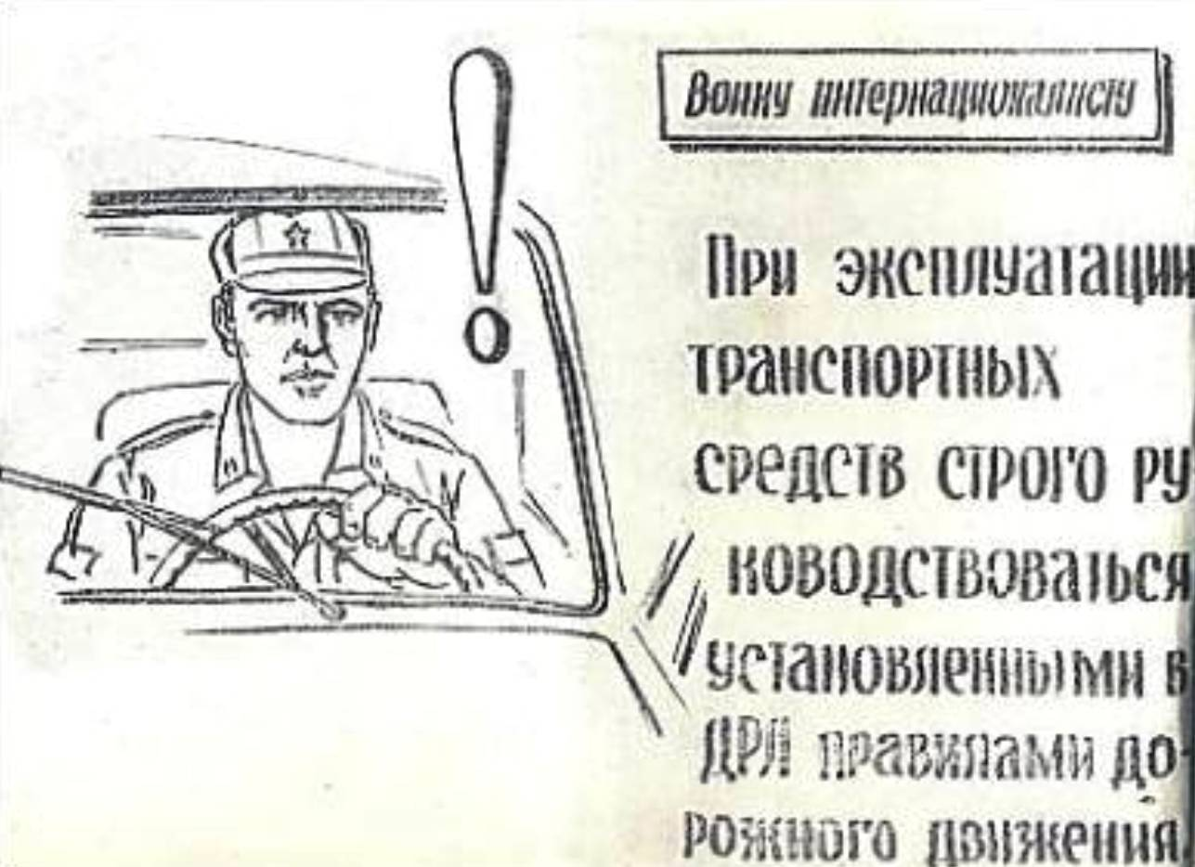
When driving always strictly adhere to the rules of the road established by the Democratic Republic of Afghanistan. 21 of 22

Slide 23
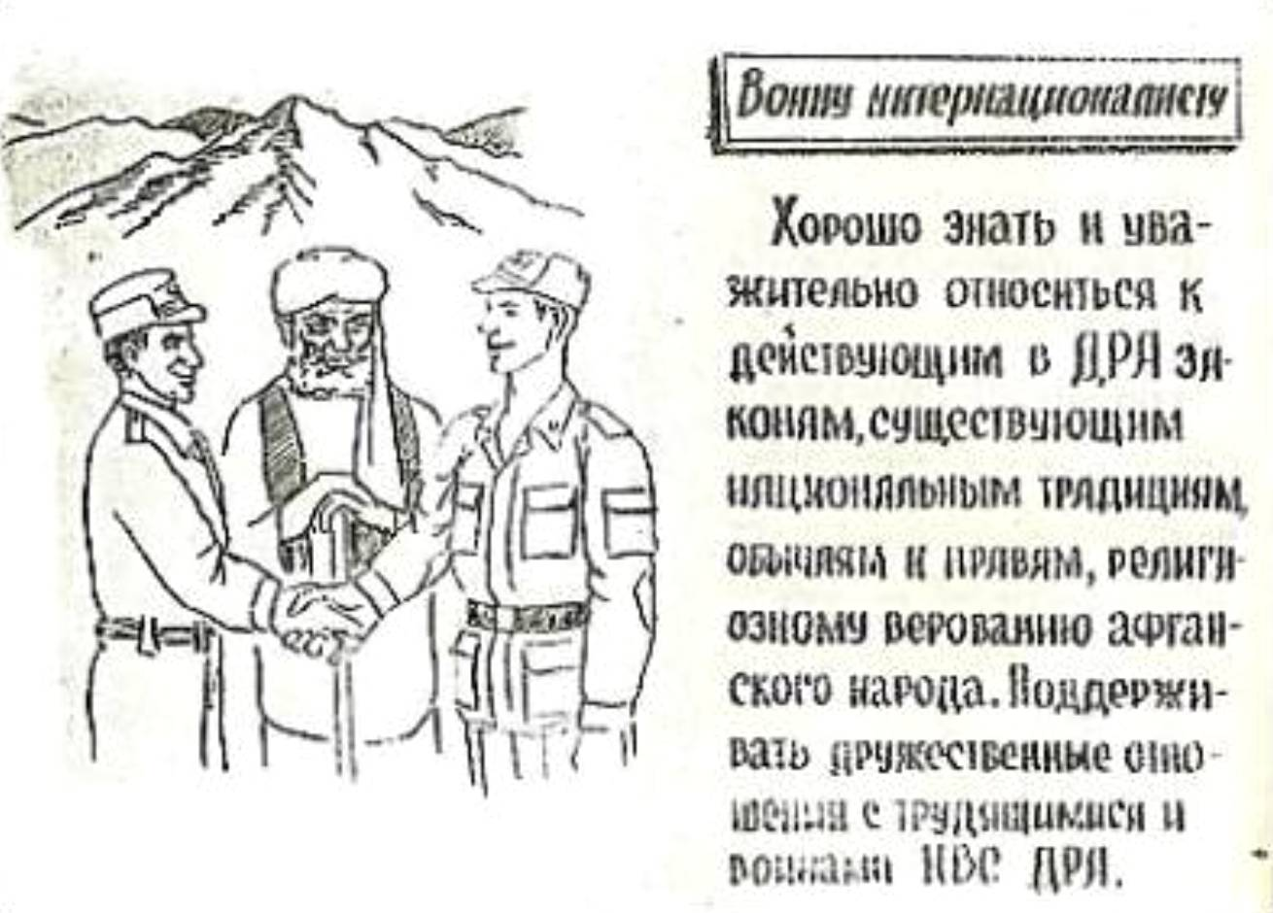
Know well and respect in action the law of the DRA, national traditions, customs and rules, and the religious faith of the Afghan people. Support friendly relations with workers and soldiers of the armed forces of the DRA [the soldier on the left in the image]. 22 of 22

